Slide 1
Masks of Latin America A Visual Collection by Bob Ibold
UNM Latin American & Iberian Institute

Slide 2
This presentation will cover…
Masks from Bob Ibold’s online collection of “Masks from around the world.”
The following are examples of masks from many different Latin American countries, including Argentina, Bolivia, Brazil, Colombia, Cuba, Dominican Republic, Ecuador, Guatemala, Mexico, Nicaragua, Panama, Peru, Puerto Rico, Paraguay, and Venezuela.

Slide 3
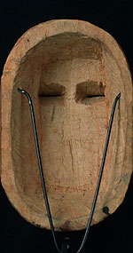
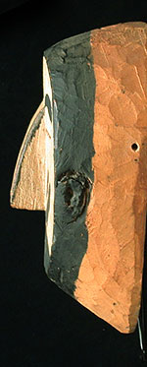
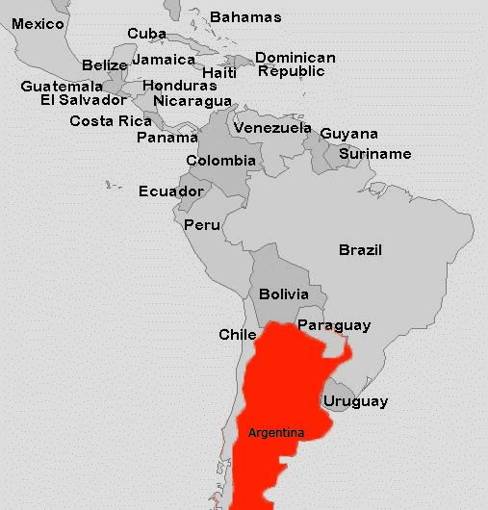
Argentina
Wichi People
Northern Argentina
9 inches, painted wood

Slide 4
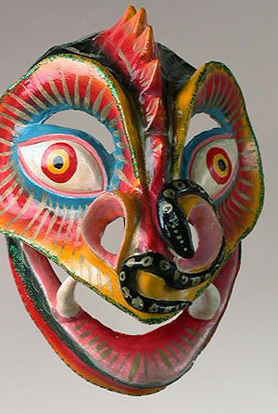
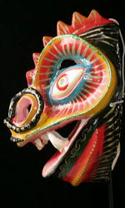
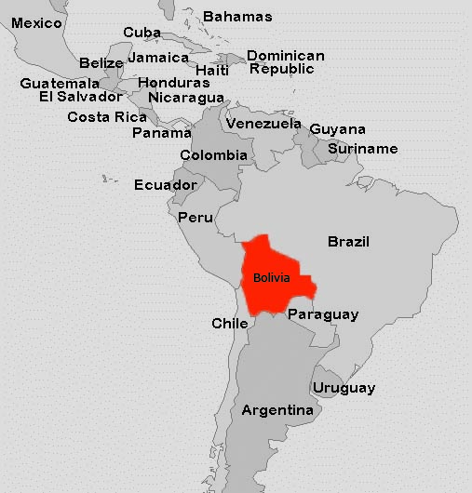
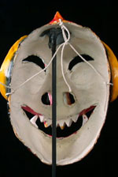
Bolivia
Devil Mask
Carnival, Oruro, Bolivia
9.5 inches, painted plastered cloth

Slide 5
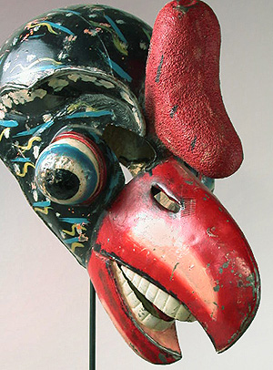
Bolivia
Condor Mask
Carnival, Oruro, Bolivia
15.5 inches, painted metal

Slide 6
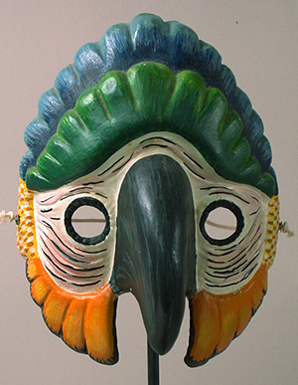
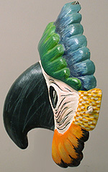
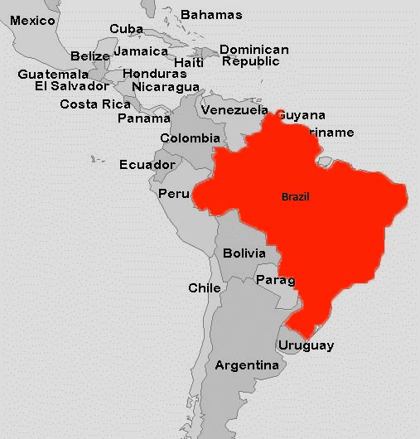
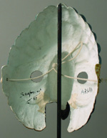
Brazil
Brazilian Parrot mask
Carnival, Brazil
6 inches, rigid papier mâché, paint

Slide 7
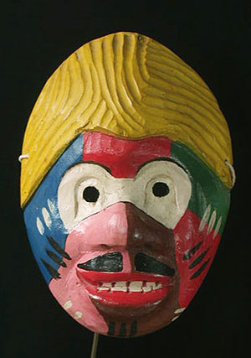
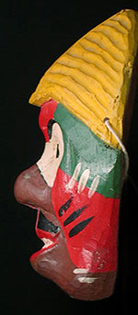
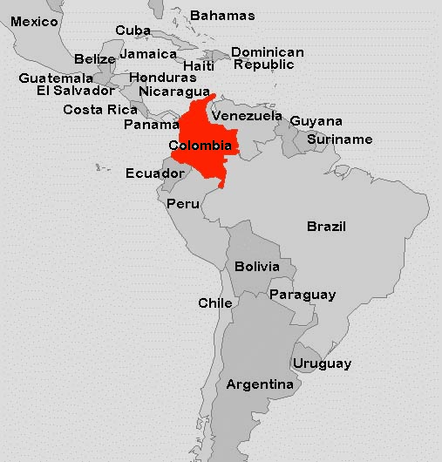
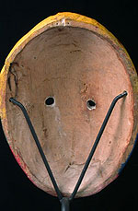
Colombia
Character mask
Colombia
9 inches, painted wood

Slide 8
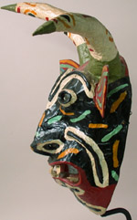
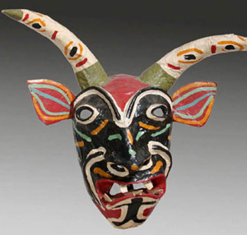
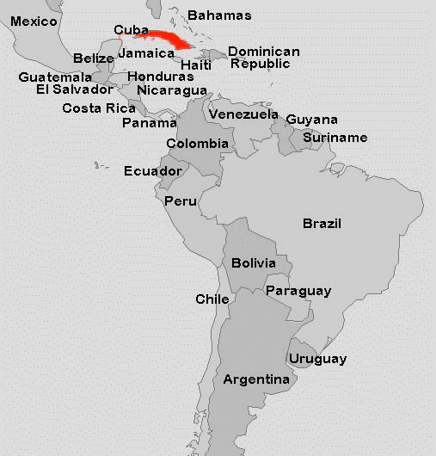
Cuba
Cuban Devil mask
Cuba.
18 inches wide from tip to tip of horns, painted paper-mâché.

Slide 9
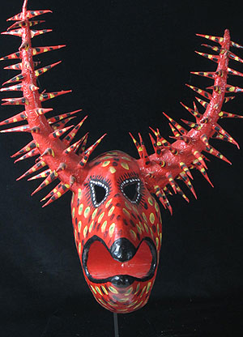
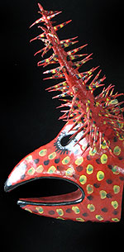
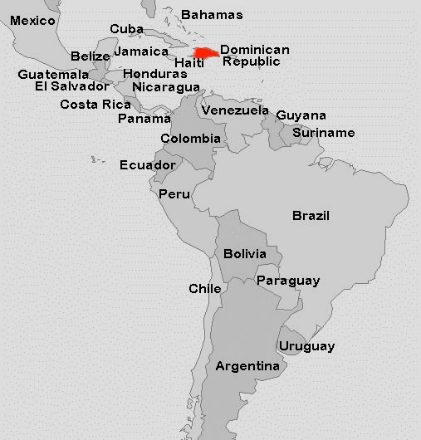
Dominican Republic
Lechone mask.
Santiago, Dominican Republic.
24 inches, painted paper mâché.

Slide 10
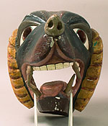
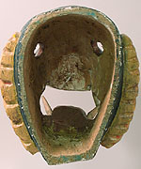
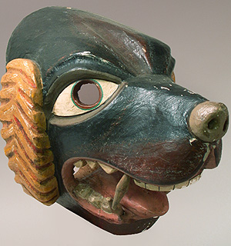
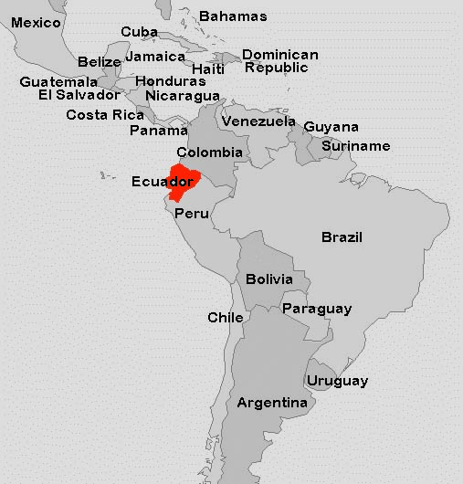
Ecuador
Ecuadorian Dog mask.
Highland Quichua people, Pinchincha, Ecuador
15 inches deep, painted wood.

Slide 11
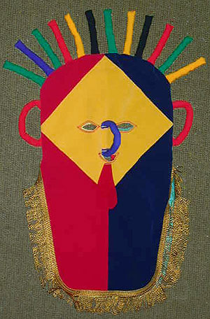
Ecuador
Diablo Umo mask
Quechua people, Ecuador
26 inches, colored fabrics

Slide 12
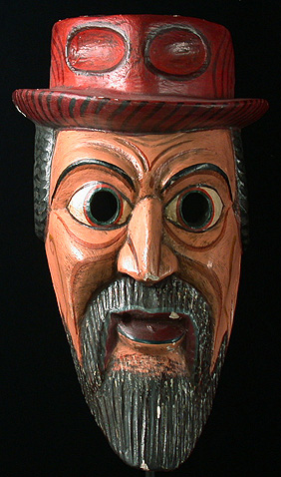
Ecuador
Character mask
Quechua people, Cotopoxi, Ecuador
16 inches, painted wood

Slide 13
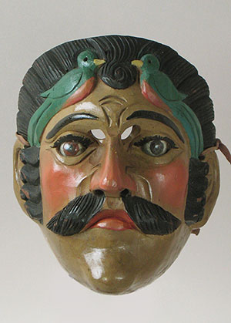
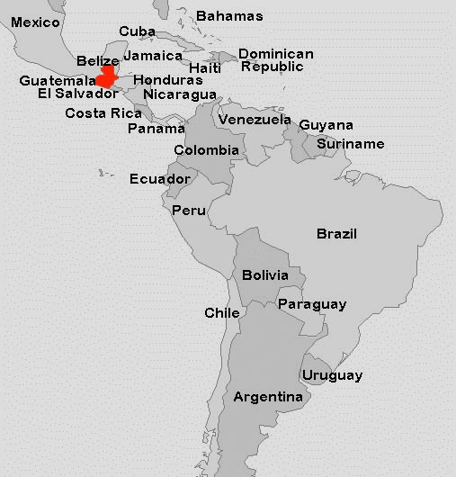
Guatemala
Tecun Uman Mask
Guatemala
8.5 inches, painted wood, glass

Slide 14
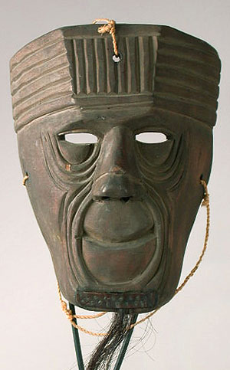
Guatemala
Xacalcoje Mask
Totonicapán, Guatemala
8.5 inches, wood

Slide 15
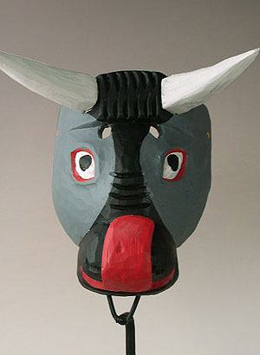
Guatemala
Torito dance, Guatemala
8.5 inches, painted wood

Slide 16
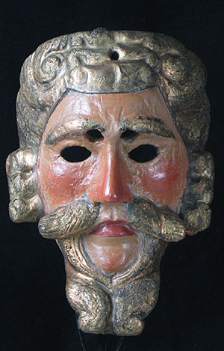
Guatemala
San Cristobal Totonicapan, Guatemala
8.5 inches, painted wood

Slide 17
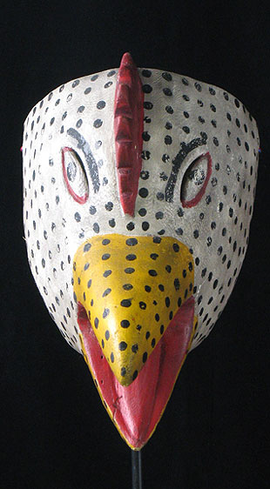
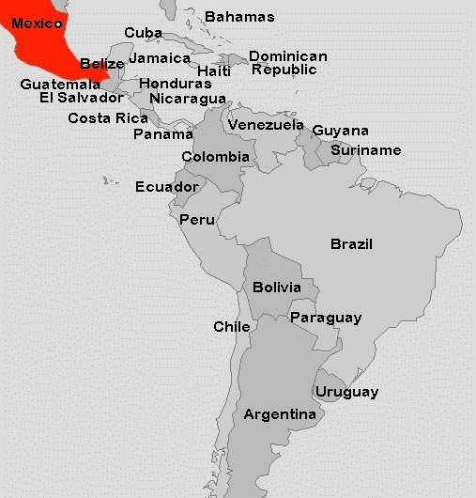
Mexico
Rooster mask.
Carpinteros, Hidalgo, Mexico.
11.5 inches long, painted wood.

Slide 18
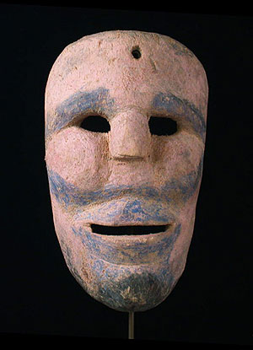
Mexico
Xantolo mask for Día de los Muertos
8 inches, wood

Slide 19
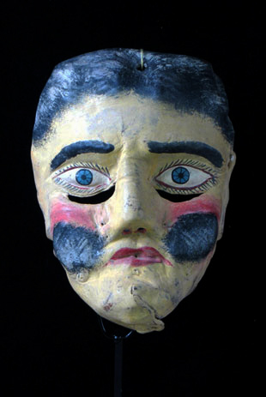
Mexico
Mexican Macho Mula mask
Costa Chica, Guerrero
8.5 inches, painted leather

Slide 20
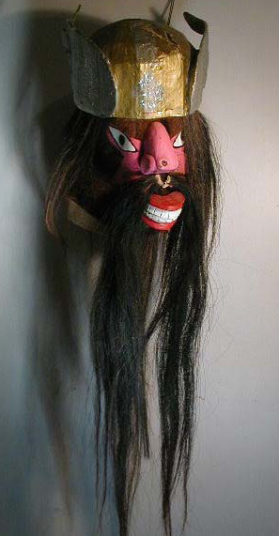
Mexico
Mexican Chapayeka Mask
Yaqui people, Sonora, Mexico
14 inches, goatskin helmet, painted wood face, cardboard crown, horse hair beard

Slide 21
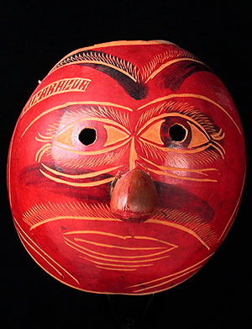
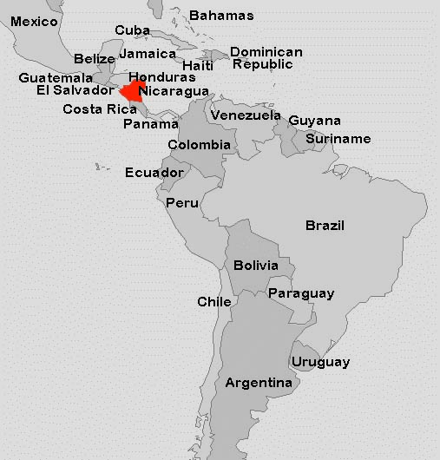
Nicaragua
Tourist mask.
7 inches, carved gourd.

Slide 22
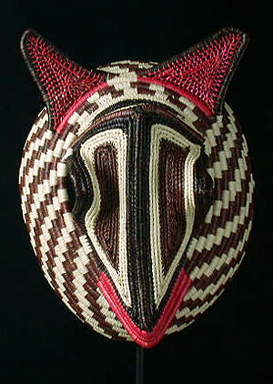
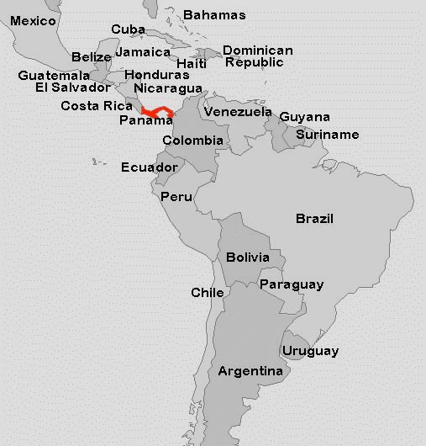
Panama
Animal mask
Wounaan-Embera culture, Darien Province.
10 inches, woven palm.

Slide 23
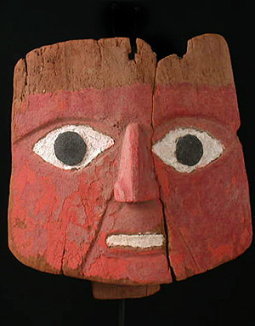
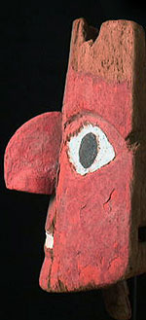
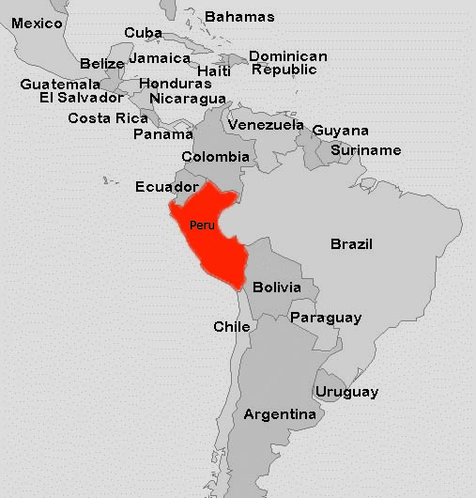
Peru
Mummy bundle mask
Chancay culture, Pre-Columbian Peru
9 inches, painted wood

Slide 24
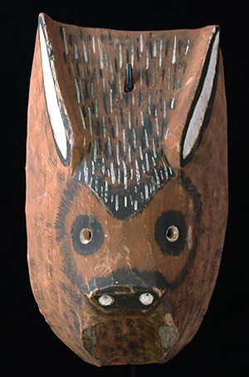
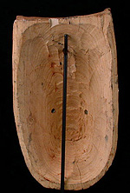
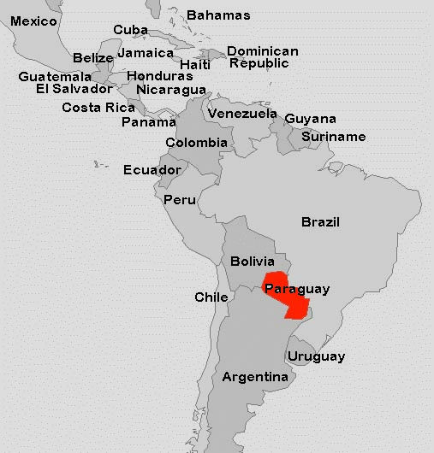
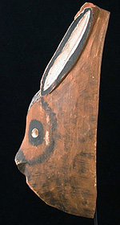
Paraguay
Rabbit mask
Chiriguanos Indians, Paraguay
13 inches, wood

Slide 25
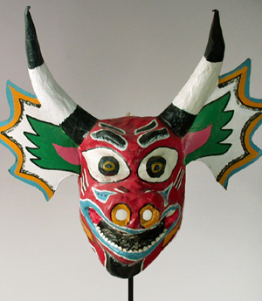
Venezuela
Diablo mask
Festival of Corpus Christi, Venezuela
22 inches wide, painted papier mâché

Slide 26
Acknowledgment
Bob Ibold is the curator and owner behind the website “Masks from around the world,” a rich digital collection of masks representing cultures of nearly every continent. The masks presented here are only a sliver of the images available online.
For more information about this collection, visit www.masksoftheworld.com
Please note that all images (with the exception of the maps) and their descriptions presented in this slide show are reproduced with Ibold’s permission. Please contact him directly if you intend to re-use or redistribute this content.

